Slide 1
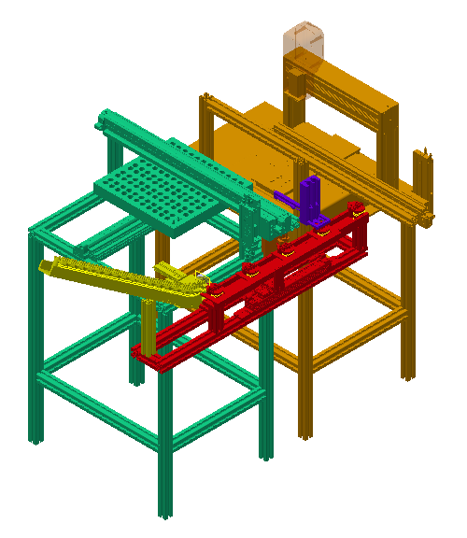
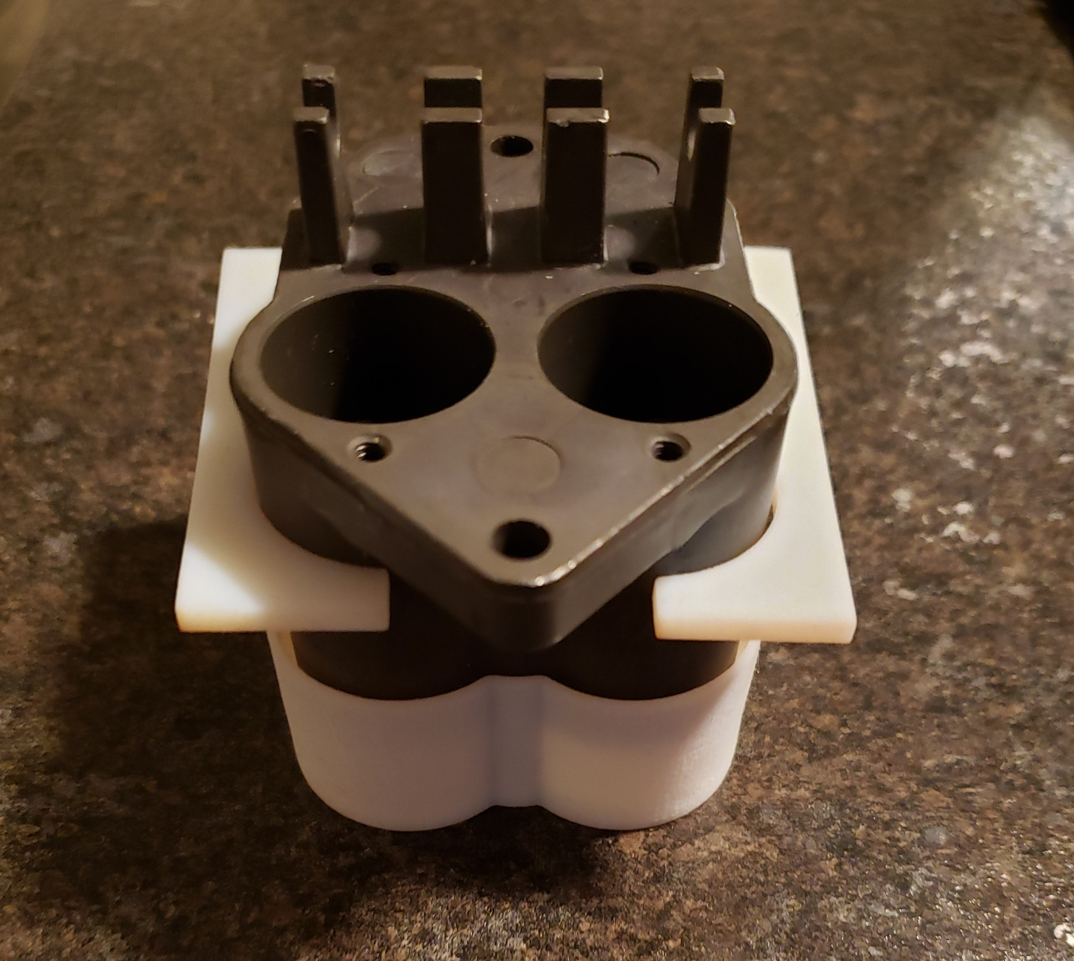
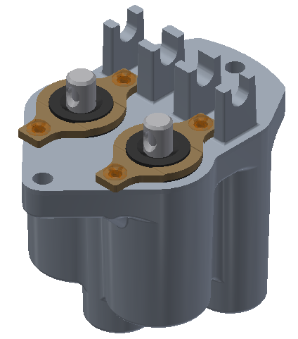
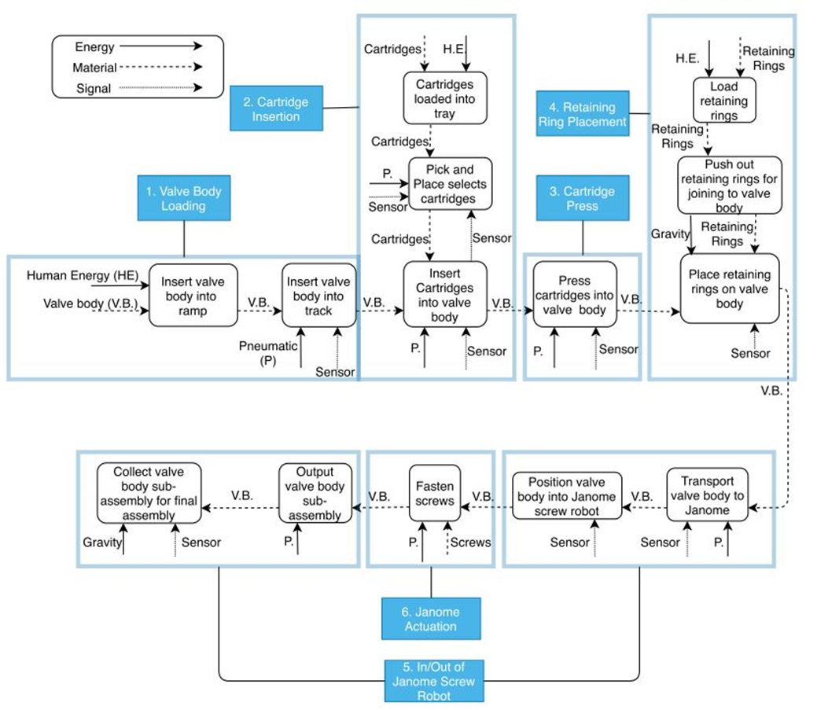
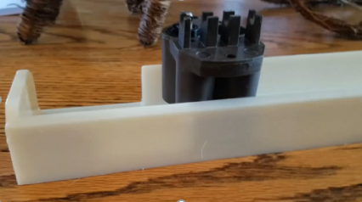
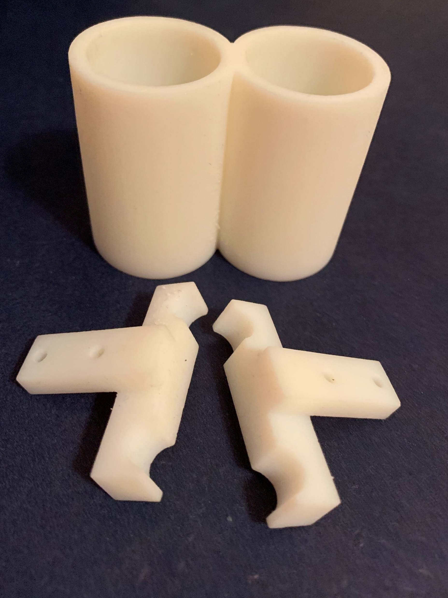
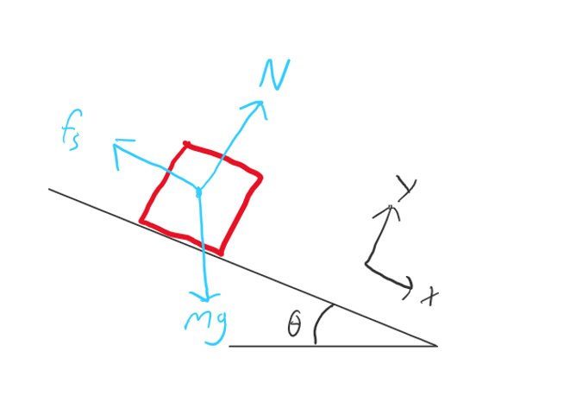
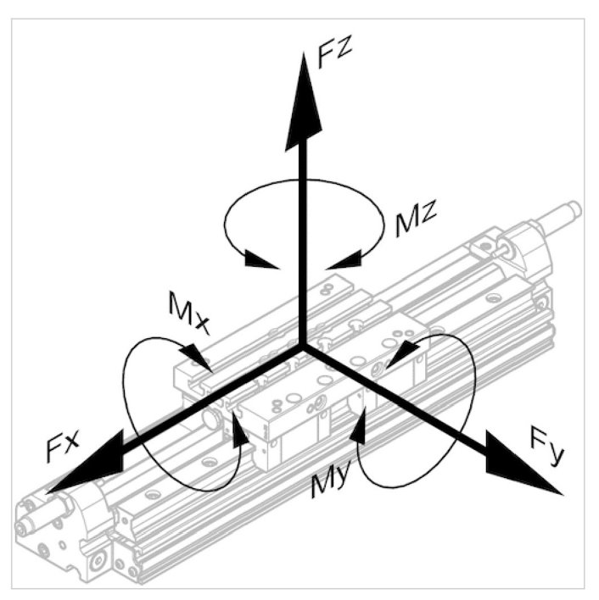
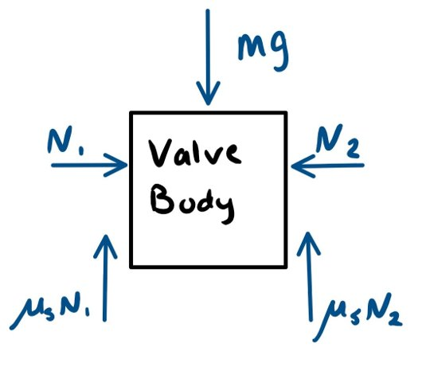
Automated Air Valve Assembly
Presenter(s): John Usher, Ben Cochran, Matthew Courtwright, Ben Walker, Byron Judy
Department of Mechanical Engineering
University of Kentucky, Lexington, KY
Problem Description
Preliminary Prototypes
AVENTICS currently produces the 2-HA-2 Air Valve Assembly as a manual assembly process. AVENTICS, being a producer of various pneumatic solutions, has sought to automate this process to showcase their products and to bring greater efficiency to a current process.
The 2-HA-2 Air Valve Assembly is composed of an air valve body, two cartridges, two retaining rings, and four screws. AVENTICS owns a screw fastening robot, so the team will design a process that feeds fluidly into the screw fastener.
The designed system must be able to select one valve body, place two cartridges into valve body, press the cartridges into place, orient and place two retainers onto two previously inserted cartridges, locate the subassembly in the Janome screw fastening robot, actuate the Janome screw fastening robot, and move the complete subassembly to lineside bin after screws are fastened for final assembly. The system should be designed with a life span of 20-25 years of production in mind.
The final machine assembly should use at least 70% AVENTICS products to demonstrate their capabilities.
3-D printing has been used to make preliminary prototypes of various components, as seen below.
The final concept selected is composed of six major subsystems
Product Architecture
The product architecture can be divided into six sub-systems with an additional system dedicated to movement of the valve body between stations. The diagram below shows the movement of energy, material, and signal through the system.
3-D printed grippers and holder for valve body
Assembled 2-HA-2 valve
3-D printed slide track for valve body
Functional Flow Diagram of prototype system
Final Concept
Analysis
3-D printed grippers and holder for cartridges
For the final concept, each subsystem is referred to as a stage in the assembly of the valve. At stage 1, shown in yellow in the picture above, the valve bodies slide off of a ramp and are pushed by a pneumatic cylinder into the track.
At station 2, shown in green in the picture above, cartridges are selected from a tray and inserted into the valve body via a pneumatic pick and place system. At station 3, shown in purple above, a pneumatic cylinder with a fixture seats both cartridges into the valve body. At station 4, shown in blue above, a pneumatic cylinder will push two retaining rings out of the dispenser onto the cartridges. At station 5, shown in orange, the valve body is moved from the track to the Janome screw fastening robot and then to the collection tray via a pneumatic gantry system. At station 6, shown in combination with station 5 in orange above, the Janome screw fastening robot inserts two screws per retainer, completing the sub-assembly. A shifting fork controlled by pneumatic cylinders will move the parts from each station to the next, which is shown in red above.
Below are the free body diagrams used in the analysis of the system. The image on the left shows the forces and moments acting on a cylinder used in the system, to make sure the specified cylinder is strong enough. The top right image shows the free body diagram used in determining the angle of the ramp that feeds valve bodies into the system. The bottom right image is the free body used for friction calculation for when a valve body is gripped to be placed into the Janome screw fastening robot.
Testing
The prototype will be tested in several stages. Since the design is modular, each subsection can be tested independently before final assembly. The main items to test are fitment, positional accuracy of the moving parts, and reliability. The fitment of all the parts that interact with the valve body will be tested before assembly with 3-D printed prototype parts. Then with each subsystem built, the positional accuracy of all moving parts will be measured. A dial indicator will be mounted near the nominal position of the moving parts and used to measure how far the location deviates from the nominal location. Once each subsystem has been tested and confirmed to work, the overall system will be assembled. Trial runs will then be conducted to fully assemble the air valves. The failures and successes will be recorded to find the weak links and reliability rate.
Examples of analysis conducted for the prototype

